Slide 1
Updating Development Impact Fees
Focus Group Meeting #2
May 13, 2024

Slide 2
Purpose of Presentation
Review Meeting #1 Follow Up Items
Discuss Infrastructure Improvement Plans
Streets
Parks
Trails
Introduce Construction Sales Tax Offset
Fee Calculation Example (Fire & Medical)
Review Calendar

Slide 3
1. Review Meeting #1 Follow Up Items
Land Use Assumptions and Growth Assumptions
More Information to be Provided for All 5 Land Uses
Evaluate Growth Assumptions in State Lands
Infrastructure Improvement Plans
Police Infrastructure Evaluated for Existing Level of Service

Slide 4
2. Review Infrastructure Improvement Plans (IIP)

Slide 5
Streets IIP

Slide 6
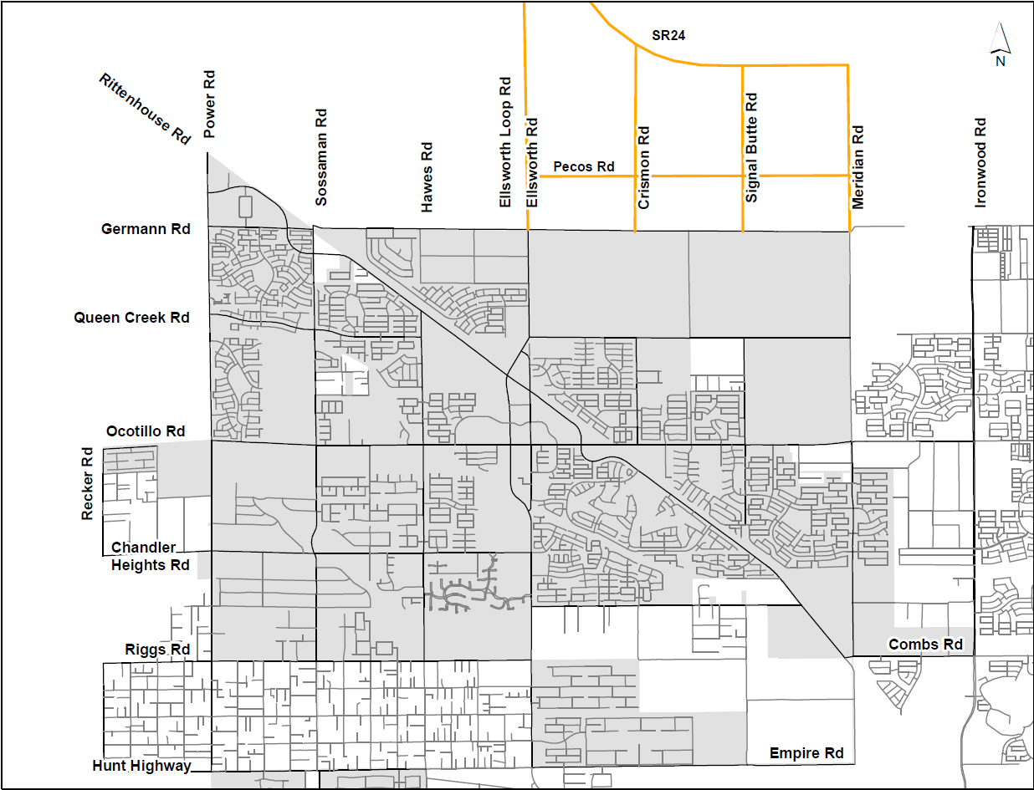
Streets IIP
Key
= Completed Project
= Active Project
= Future Project (w/in 5Yrs) = Future Project (Beyond 5)
30
19
9
14
17
29
Traffic Signal
Completed
18
8
4
34
7
Traffic Signal
Active
36
16
Traffic Signal
Future
3
2
24
1
10
21
6
5
11
22
37
32
31
13
33
25
26
23
27
28
12
35
15

Slide 7
Streets IIP: $196.8M
Proposed IIP from Adopted Master Plan: $196.8M
Summary of Projects
Continue Aggressive Construction of New Streets
Master Plan Update Ongoing (Estimated Completion Date: Summer 2025)
Comparison of Expenses
 | Current Fee | Proposed Fee | Change
Existing Infrastructure | N / A | N / A | N / A
Existing Debt | $3.5M | $9.2M* | $5.7M
Projects (IIP) | $147.1M | $196.8M | $49.7M
Total | $150.6M | $206.0M | $55.4M
*Currently evaluating opportunity for reduction by paying off existing debt.

Slide 8
Solving the
Transportation
Puzzle
In Queen Creek
Mohamed Youssef, PE, PTOE Public Works Director
Town of Queen Creek

Slide 9
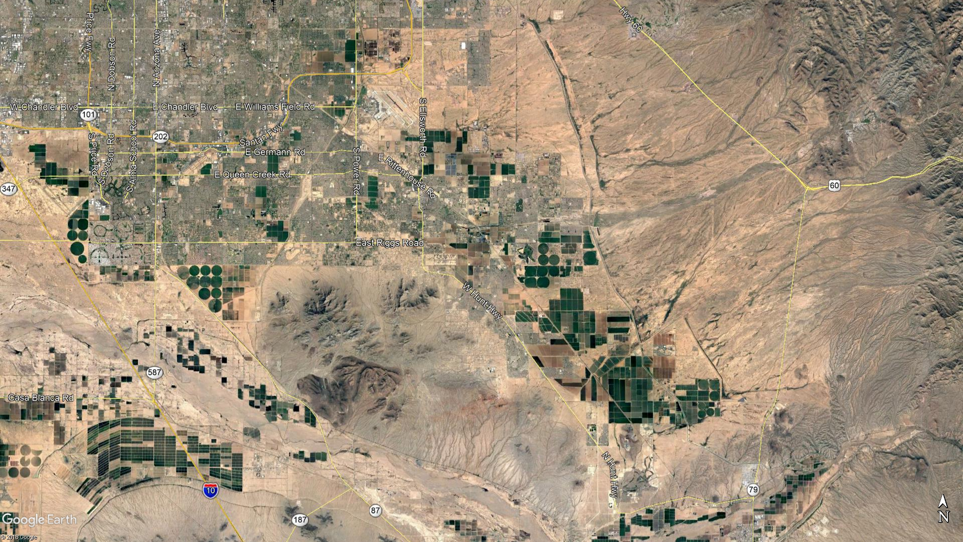
101
24
202
2023:
197,028

Slide 10
101
24
202
2030:
240,234

Slide 11
101
24
202
2045:
314,241

Slide 12
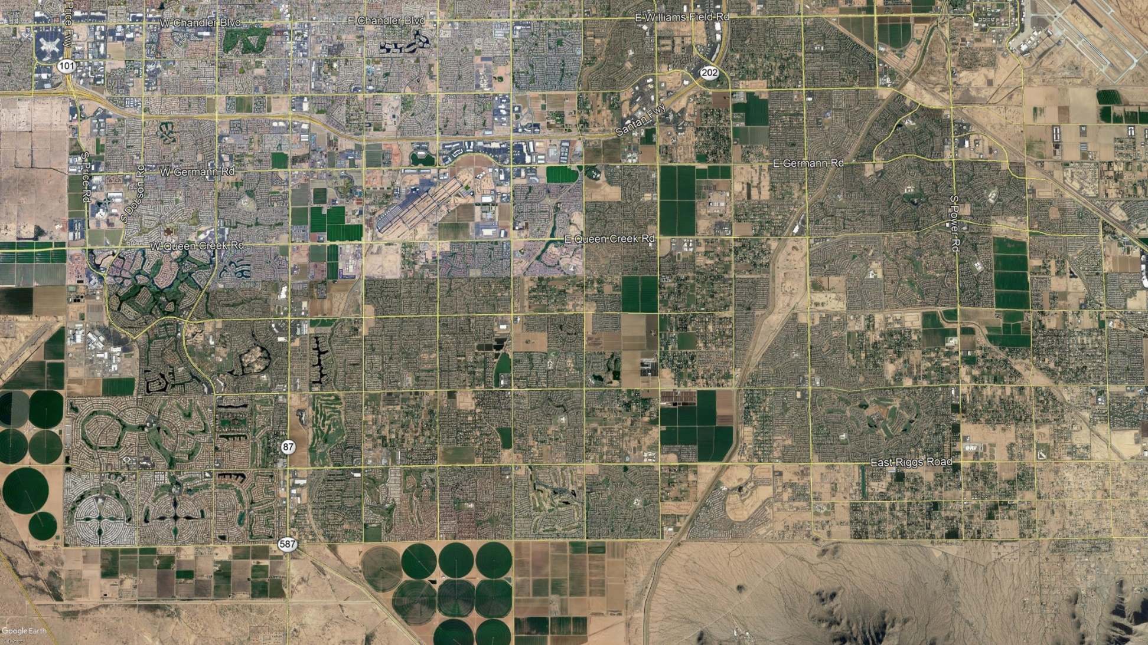
Typical Grid System
9
8
1
2
3
7
4
5
6
10

Slide 13
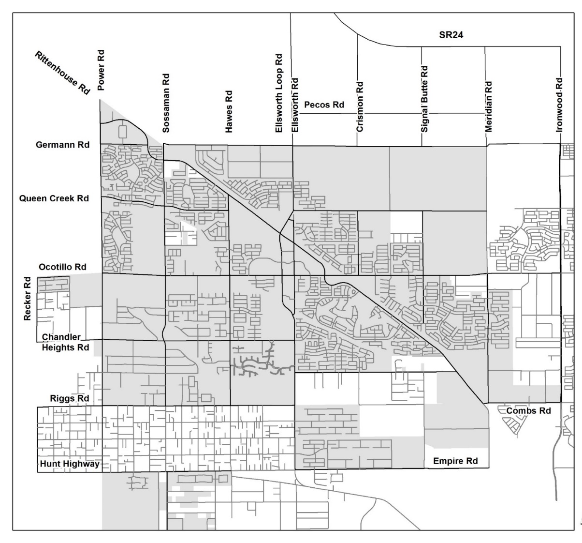
Perfect Grid System

Slide 14
Queen Creek Grid System – AT BUILD-OUT

Slide 15
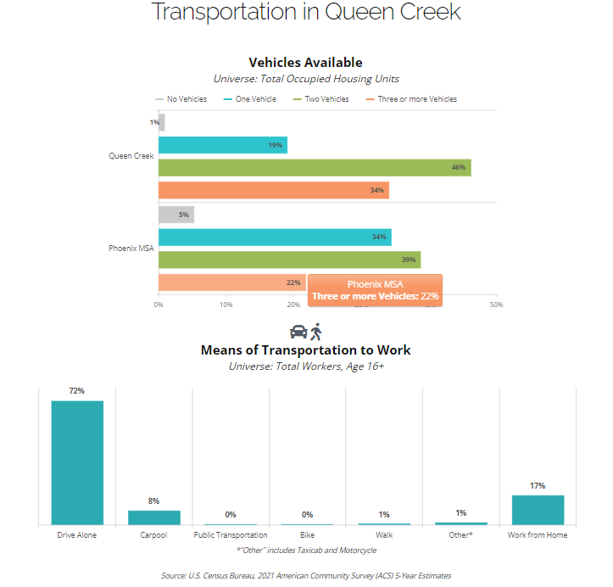
80%
Two or more Vehicles
72%
Drive Alone

Slide 16
Average Commute Time In Queen Creek

Slide 17
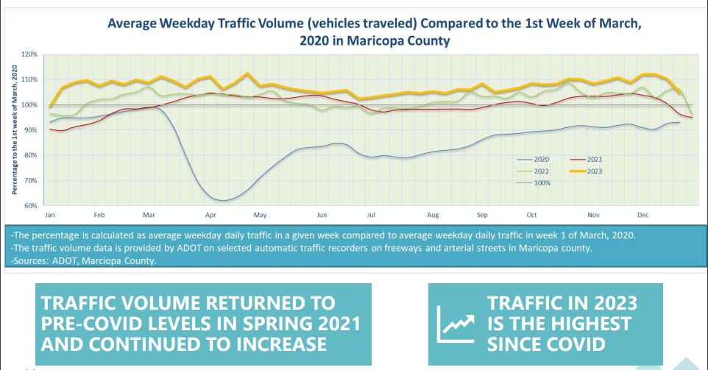

Slide 19
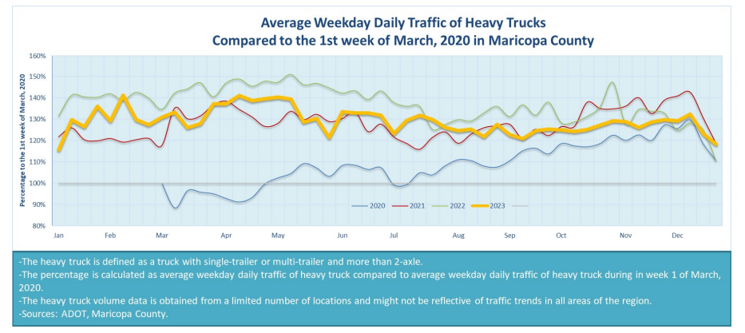
Up to 30% increase in truck traffic

Slide 20
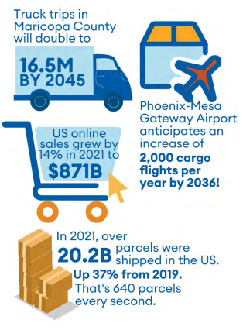

Slide 21
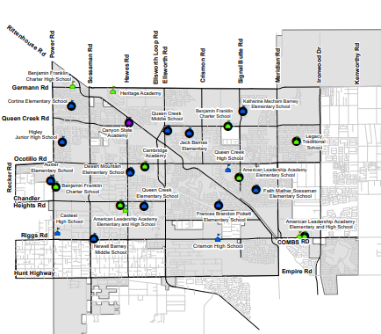
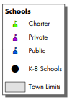
How dropping the kids off at school became the norm

Slide 22
TRANSPORTATION PLANNING STUDIES
Queen Creek Transportation Master Plan Update (Summer 2025)
Queen Creek Mobility Options and Connectivity Feasibility Study
Queen Creek Safety Action Plan
Pinal County Transit Study
Superstition Vistas Multimodal Transportation Planning Study
Gold Canyon Transportation Planning Study

Slide 23
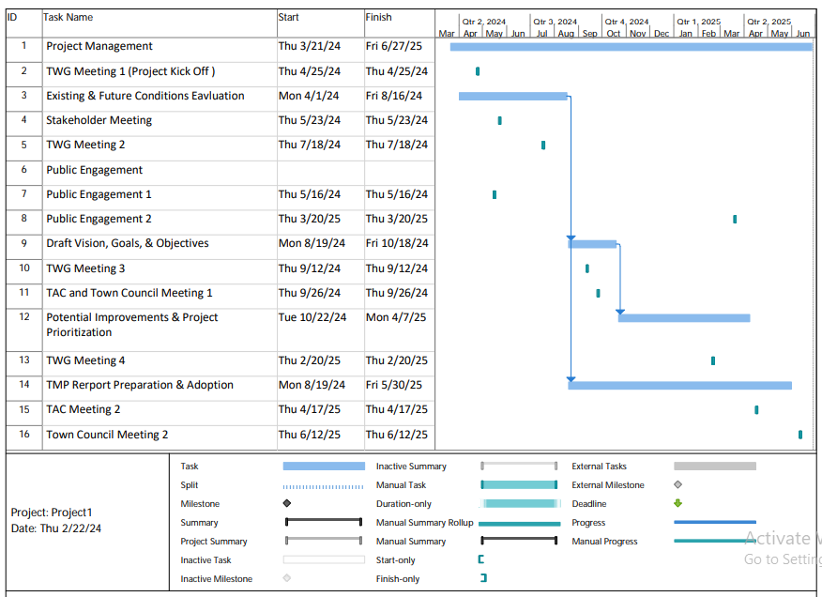
Queen Creek Transportation Master Plan Update Schedule

Slide 24
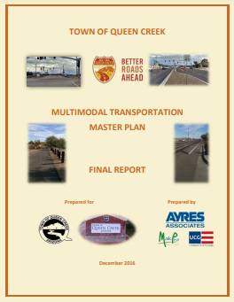
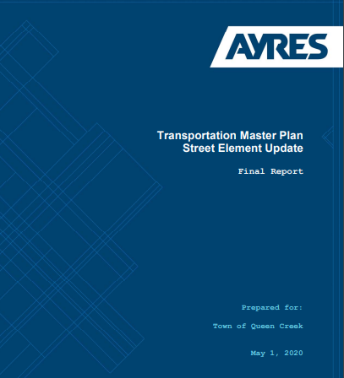
10-Year IIP Roadway Projects
2018-2027 (Over $300 M Transportation Investment)
Key
= Completed Project
= Active Project
= Remaining Project
Traffic Signal
Completed
Traffic Signal
Future
December 2016
May 2020
Notes:
No updates to this map this quarter. We are hopefully going to have a few for our next meeting.

Slide 25
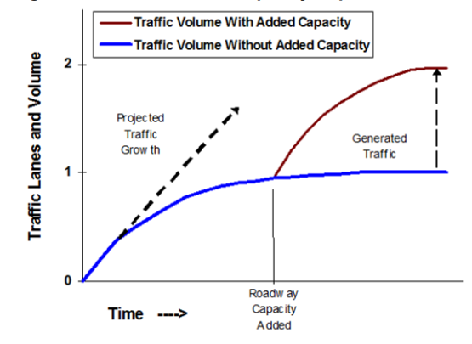
How Road Capacity Expansion Generates Traffic
Traffic grows when roads are uncongested, but the growth rate declines as congestion develops, reaching a self-limiting equilibrium (indicated by the curve becoming horizontal). If capacity increases, traffic grows until it reaches a new equilibrium. This additional peak-period vehicle travel is called “generated traffic.” The portion that consists of absolute increases in vehicle travel (as opposed to shifts in time and route) is called “induced travel.”

Slide 26
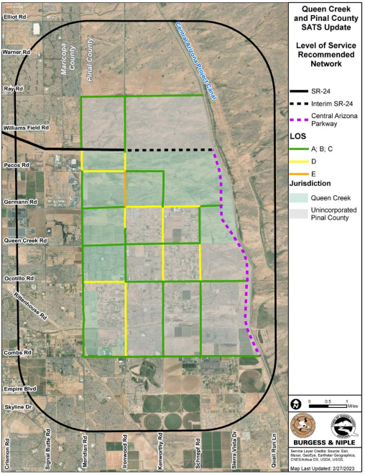
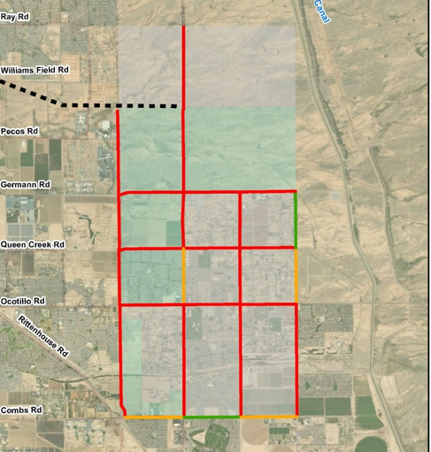
2030 Level of Service 2.0
2030 with SR 24 EXT. and Pinal Pkwy
2030 without SR 24 EXT. and Pinal Pkwy
Wheatley, Goodman: Hobbs must restore SR 24 funds

Slide 27
Streets IIP: $196.8M
Map ID # | Projects | Years 1-5 | Years 6 - 10
1 | Town Center: Aldecoa-Munoz-Summers | $10.2M
2 | Ocotillo Road: 226th to Ironwood | $0.1M
3 | Ocotillo Road: West of Sossaman Rd to Hawes Rd | $16.6M
4 | Hawes Road: Ocotillo to Rittenhouse | $5.1M
5 | Chandler Heights: Hawes to Ellsworth | $3.3M
6 | Chandler Heights: Sossaman to Hawes | $10.5M
7 | Signal Butte: Ocotillo to Queen Creek | $1.4M
8 | Queen Creek Road: Ellsworth to Crismon | $0.9M
9 | Germann Rd: Ellsworth to Crismon | $3.2M
10 | Power Road: Brooks Farms to Chandler Heights | $0.3M
11 | Power Road: Chandler Heights to Riggs | $11.7M
12 | Power Road: Riggs to Hunt Hwy | $6.4M

Slide 28
Streets IIP: $196.8M (continued)
Map ID # | Projects | Years 1-5 | Years 6 - 10
13 | Meridian Road: Combs to Queen Creek Wash | $0.2M
14 | Ryan Road: Crismon to Signal Butte | $4.8M
15 | Hunt Hwy: Power to Sossaman |  | $3.2M
16 | Traffic Signal: Ocotillo & Scotland Court |  | $1.0M
17 | Meridian Road: Queen Creek Road to Germann | $7.6M
18 | 220th: Queen Creek to Ryan | $3.3M
19 | Sossaman Railroad Crossing @ Germann | $4.6M
20 | Ironwood Road Improvements | $0.9M
21 | Sossaman: Sonoqui Wash to Chandler Heights | $10.6M
22 | Sossaman: Chandler Heights to Riggs | $3.6M
23 | Sossaman: Riggs to Empire |  | $8.4M
24 | Hawes: Chandler Heights to Ocotillo | $14.0M

Slide 29
Streets IIP: $196.8M (continued)
Map ID # | Projects | Years 1-5 | Years 6 - 10
25 | Hawes: Riggs North to Sunset Drive (1/2 mile, 3 lanes) NEW | $6.5M
26 | Southeast Park - Riggs Road (1/4 mile, 3 lanes) | $3.2M
27 | Southeast Park - Crismon Road to cul-de-sac (1/4 mile, 3 lanes) | $3.2M
28 | Combs: Meridian to Gantzel - West of Sangria | $1.3M
29 | Ironwood: Pima to Germann | $30.0M
30 | Traffic Signal: Germann Road and 196th Street | $1.8M
31 | Traffic Signal: Harvest: Harvest @ Riggs Road | $1.2M
32 | Traffic Signal: Harvest: Signal Butte & Riggs | $1.4M
33 | Traffic Signal : Combs @ Sangria | $1.4M
34 | Traffic Signal: 220th @Queen Creek Road | $1.3M
35 | Traffic Signal: Power Road @ San Tan | $0.4M
36 | Traffic Signal: Ocotillo @ Recker ( IGA with Gilbert) (1/2 Third Party Removed) | $0.8M

Slide 30
Streets IIP: $196.8M (concluded)
Map ID # | Projects | Years 1-5 | Years 6 - 10
37 | Traffic Signal: Riggs @206th | $1.5M
38 | Traffic Signal: Queen Creek @ 188th | $0.3M
39 | Traffic Signal: Gary Road and Grange Parkway | $0.3M
40 | Traffic Signal: Ellsworth @ San Tan Blvd | $0.4M
41 | Traffic Signal: Riggs @ Crismon High School | $0.3M
 | Project Management | $9.8M
 | Total | $196.8M

Slide 31
Parks and Trails IIPs

Slide 32
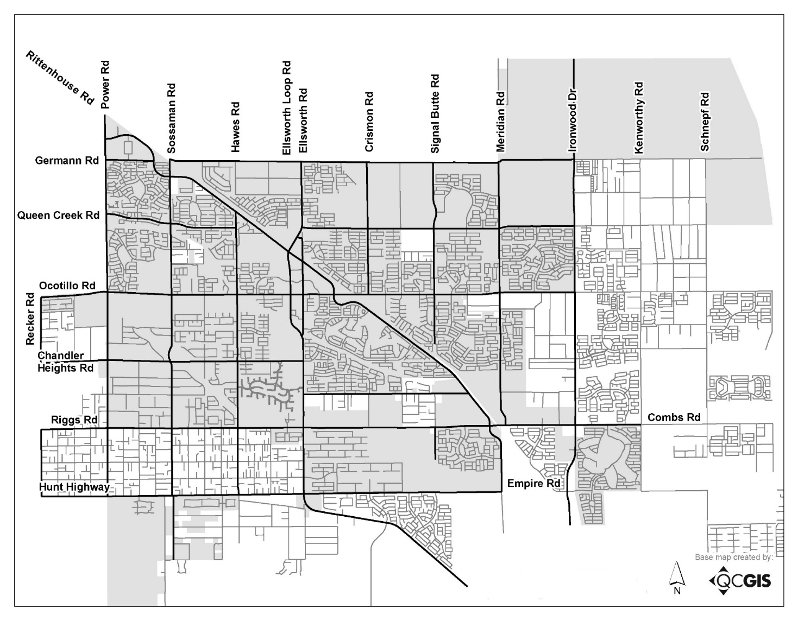
Parks and Trails IIPs
SR24
Frontier Family Park
85 Acres
Pima/Meridian Park
52 acres
Mansel Carter
Phase 2
Bosma
30 Acres
Southeast Park
73 acres

Slide 33
Parks IIP: $295.0M
Existing Acres: 187 (6 Parks)
Acres Being Purchased: 155 (3 Parks)
Acres Being Constructed: 155 (3 Parks)
Impact Fees Pay for 90 Acres (30 Acres per Park)
Comparison of Expenses
 | Current Fee | Proposed Fee | Change
Existing Infrastructure | N / A | N / A | -
Existing Debt | $4.8M | $4.3M | ($0.5M)
Projects (IIP) | $57.0M | $295.0M | $238.0M
Total | $61.8M | $299.3M | $237.5M

Slide 34
Parks IIP: $295.0M
Projects | Years 1-5 | Years 6 - 10
1. Frontier Family Park (85 Acres) | $72.8M*
2. Southeast Park Land Only (73 Acres) | $22.1M
3. Pima / Meridian Park Land Only (52 Acres) | $23.4M
4. Bosma Park Land Only (30 Acres) | $15.0M
5. Project Management | $6.2M
6. Southeast Park – Construction (73 Acres) |  | $73.5M
7. Pima / Meridian Park – Construction (52 Acres) |  | $52.0M
8. Bosma – Construction (30 Acres) |  | $30.0M
Total | $139.5M | $155.5M
* Potentially reduced or eliminated because in current fee.

Slide 35
Trails IIP: $11.5M
Proposed IIP from Adopted Master Plan: $11.5M
Comparison of Expenses
 | Current Fee | Proposed Fee | Change
Existing Infrastructure | N / A | N / A | -
Existing Debt | N / A | N / A | -
Projects (IIP) | $6.6M | $11.5M | $4.9M
Total | $6.6M | $11.5M | $4.9M

Slide 36
Trails IIP: $11.5M
Projects | Years 1-5 | Years 6 - 10
1. QC Wash Trail – Rittenhouse to Meridian | $4.8M
2. Sonoqui Wash – Power to Recker | $1.3M
3. SRP Utility Easement Trail – Ellsworth to Signal Butte | $1.5M
4. Trail by Southeast Park Site |  | $3.4M
5. Project Management | $0.5M
Total | $8.1M | $3.4M

Slide 37
2. Review Infrastructure Improvement Plans (IIP)

Slide 38
Total IIPs: $715.3M
Infrastructure | Proposed IIP
Police | $144.1M
Fire | $67.9M
Streets | $196.8M
Parks | $295.0M
Trails | $11.5M
Total | $715.3M

Slide 39
Police, Fire & Medical, and Parks IIPs
SR24
Frontier Family Park
Aquatic & Rec Center
Fire Station 7
(actual location TBD)
Fleet Expansion
Pima/Meridian Park
52 acres
Mansel Carter
Phase 2
Public Safety Complex
Shared Use
Police Complex 3
Police Complex 2-
Muni Campus Expansion
Bosma
30 Acres
Police Complex 2-
Muni Campus
Parking Structure
Fire Station 6
Southeast Park
73 acres
Fire Station 8

Slide 40
Transportation IIP
Key
= Completed Project
= Active Project
= Future Project (w/in 5Yrs) = Future Project (Beyond 5)
30
19
9
14
17
29
Traffic Signal
Completed
18
8
4
34
7
Traffic Signal
Active
36
16
Traffic Signal
Future
3
2
24
1
10
21
6
5
11
22
37
32
31
13
33
25
26
23
27
28
12
35
15

Slide 41
3. Introduce Construction Sales Tax Offset

Slide 42
QC’s Dedicated 2% Construction Sales Tax
Background
Enacted by the Town Council
Effective Date: September 2005
Purpose: “To pay for growth-related service needs of the community”
Since Inception, the Tax has been Used for New Roads because the Town is Not Eligible to Receive Funding for Roads from the Maricopa County Voter Approved Gas Tax
December 2022: Resolution 1506-22 Approved Initiating a Review of Using for the Tax for Other Infrastructure

Slide 43
QC’s Dedicated 2% Sales Tax Reduces Impact Fees
Effective August 1, 2014, the Revenues from a Tax Rate in Excess of the Town’s Standard Tax Rate Must Be Used to Reduce the Amount Collected from Impact Fees
QC’s Standard Sales Tax Rate: 2.25%
Construction Sales Tax Rate: 4.25% (+2% Dedicated Tax)
It is a Direct Reduction from the Project Costs Used to Calculate Development Impact Fees
2% Dedicated Sales Tax + Development Impact Fees = Growth IIP

Slide 44
2% Construction Sales Tax Projections
Challenges with Projections
Corelates to Land Use Development Projections
Inflation Estimates
Construction Activity on State Land
Current Fee Study
10-Year Estimate: $23.9M
Cumulative Actuals-to-Date: $65.6M
Proposed Fee Study (Draft)
10-Year Estimate: ~$145M
Amount From LGES: ~$30M
Pending: Reduction Allocation to the 4 Impact Fees

Slide 45
Dedicated 2% Construction Sales Tax 10-Year Estimate: ~$145M

Slide 46
4. Fee Calculation Example
(Fire & Medical)

Slide 47
Example: Fire Development Impact Fee Calculation
 | Amount
Proposed IIP | $73.5M

Slide 48
Example: Fire Development Impact Fee Calculation
 | Amount
Proposed IIP | $73.5M
Less Projects Not Impact Fee Eligible (Training Facilities) | ($5.6M)

Slide 49
Example: Fire Development Impact Fee Calculation
 | Amount
Proposed IIP | $73.5M
Less Projects Not Impact Fee Eligible (Training Facilities) | ($5.6M)
Subject to Existing / Growth Allocation | $67.9M

Slide 50
Example: Fire Development Impact Fee Calculation
 | Amount
Proposed IIP | $73.5M
Less Projects Not Impact Fee Eligible (Training Facilities) | ($5.6M)
Subject to Existing / Growth Allocation | $67.9M
Existing Allocation (Town) | $37.9M

Slide 51
Example: Fire Development Impact Fee Calculation
 | Amount
Proposed IIP | $73.5M
Less Projects Not Impact Fee Eligible (Training Facilities) | ($5.6M)
Subject to Existing / Growth Allocation | $67.9M
Existing Allocation (Town) | $37.9M
Growth Allocation | $30.0M

Slide 52
Example: Fire Development Impact Fee Calculation
 | Amount
Proposed IIP | $73.5M
Less Projects Not Impact Fee Eligible (Training Facilities) | ($5.6M)
Subject to Existing / Growth Allocation | $67.9M
Existing Allocation (Town) | $37.9M
Growth Allocation | $30.0M
Less: Construction Sales Tax Allocation | ($20.0M)

Slide 53
Example: Fire Development Impact Fee Calculation
 | Amount
Proposed IIP | $73.5M
Less Projects Not Impact Fee Eligible (Training Facilities) | ($5.6M)
Subject to Existing / Growth Allocation | $67.9M
Existing Allocation (Town) | $37.9M
Growth Allocation | $30.0M
Less: Construction Sales Tax Allocation | ($20.0M)
Projects Funded from Impact Fees | $10.0M

Slide 54
5. Review Calendar

Slide 55
Proposed Calendar Step 1: LUA and IIP Approval
Step # | Step | Date
1 | Review Land Use Assumptions and Infrastructure Improvement Plan | March 6, 2024 Town Council Meeting (1 of 6)
2 | Publish Land Use Assumptions and Infrastructure Improvement Plan | March 7, 2024
 | 60-Day Notice Period (Public Outreach and Collaboration Period) Focus Group Meetings | May 2 and 13
3 | Public Hearing #1 RE. Land Use Assumptions and Infrastructure Improvement Plan | May 15, 2024 Town Council Meeting (2 of 6)
 | 30 to 60-Day Waiting Period Focus Group Meeting | May 30 and June 18
4 | Approve Land Use Assumptions and Infrastructure Improvement Plan | June 19, 2024 Town Council Meeting (3 of 6)

Slide 56
Focus Group Meeting Agenda Calendar
Meeting | Agenda Topics | Date
1 | Purpose of Focus Group Review Calendar Review Land Use Assumptions Review IIPs (Police and Fire & Medical) | May 2
2 | Review Meeting #1 Follow Up Items Review IIPs (Streets, Parks, and Trails) Introduce Construction Sales Tax Offset Review a Fee Calculation Example Identify Focus Group Comments for May 15th Public Hearing | May 13
3 | Discuss Meeting #1, #2 Follow Up Items Continue Discussion of Construction Sales Tax Offset Finalize LUA and IIPs Identify Focus Group Comments for June 19th Town Council Meeting | May 30
4 | Finalize LUA and IIPs Identify Focus Group Comments for June 19th Town Council Meeting | June 18

Slide 57
Questions
and
Comments

